Slide 1
Final Mini Project Demonstration
Project Title : Department Research Component
Team No. : 1 Section G
Project Guide : Dr. Mamatha H.R.
Project Team : Mehul Thakral PES1201701122
Skanda VC PES1201700987
Venkatesh K PES1201701626

Slide 2
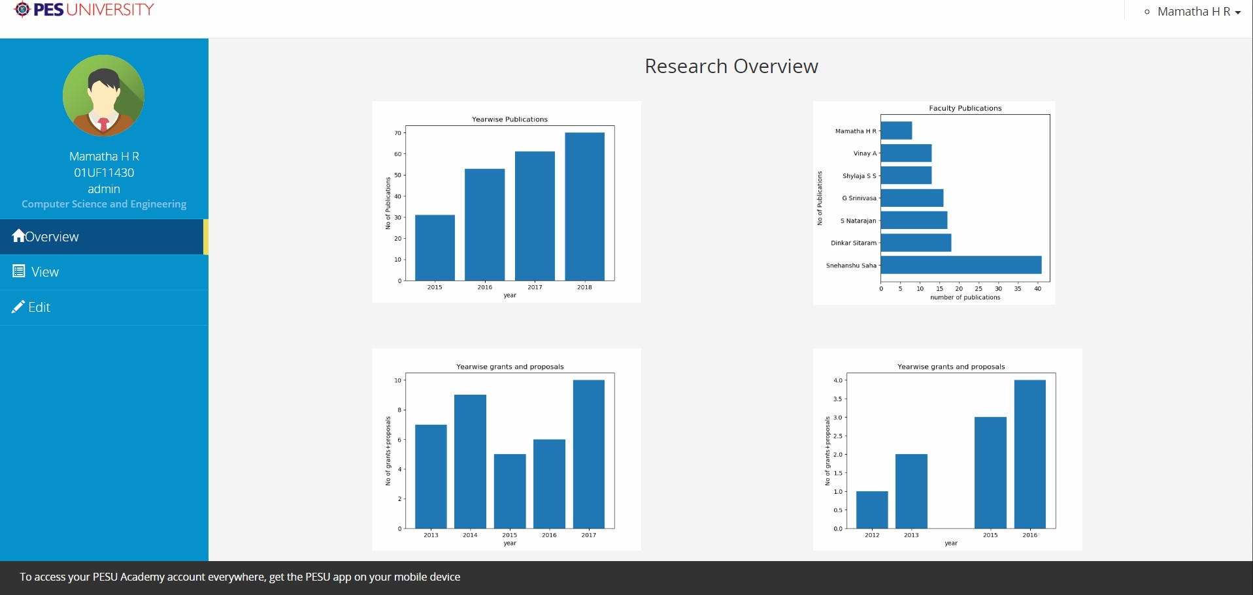
Research Overview
A overview of research activities in PES !

Slide 3
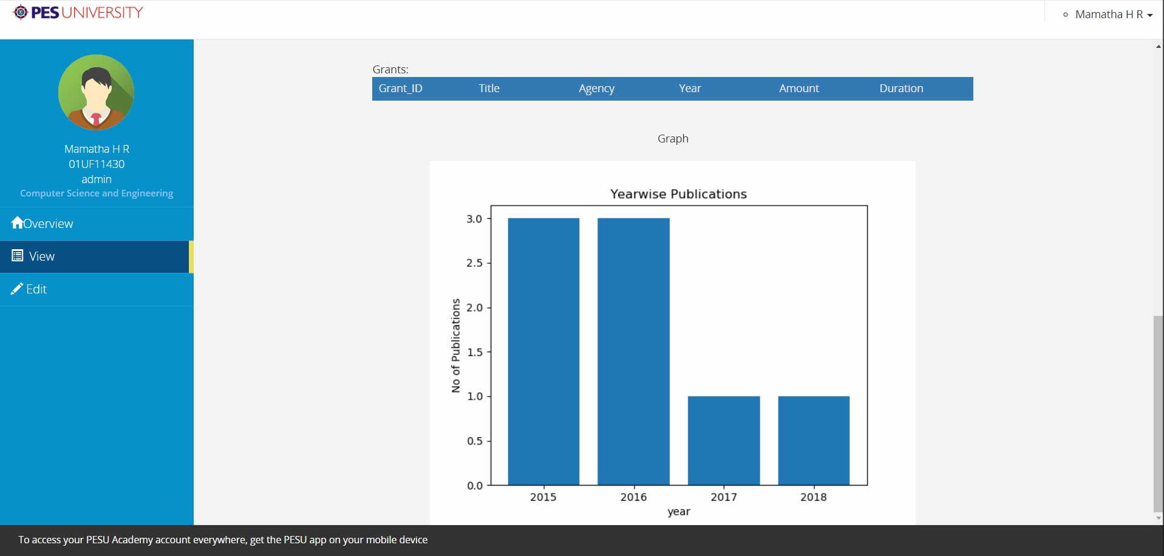

Slide 4
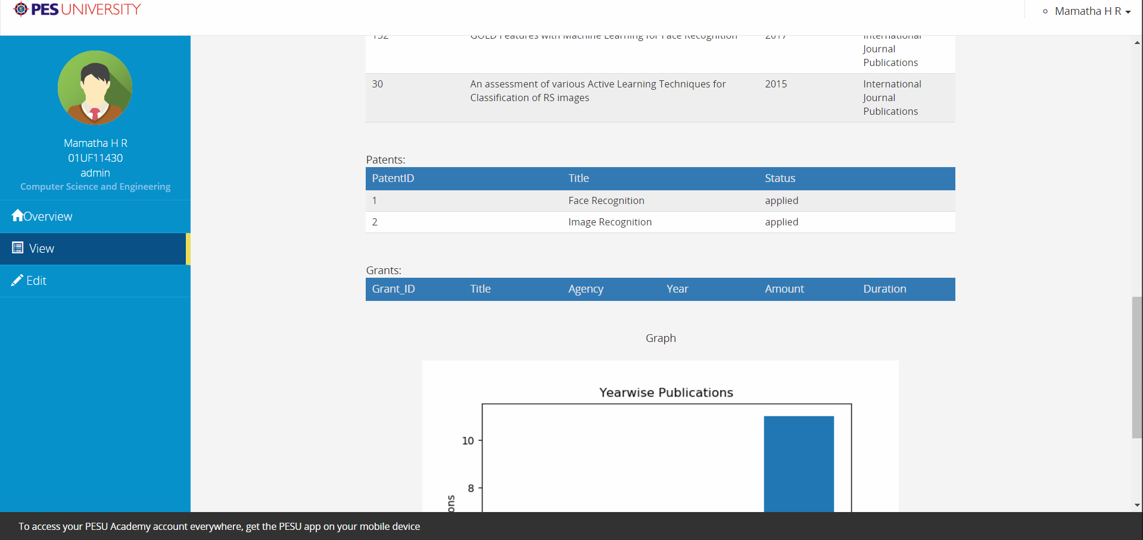

Slide 5
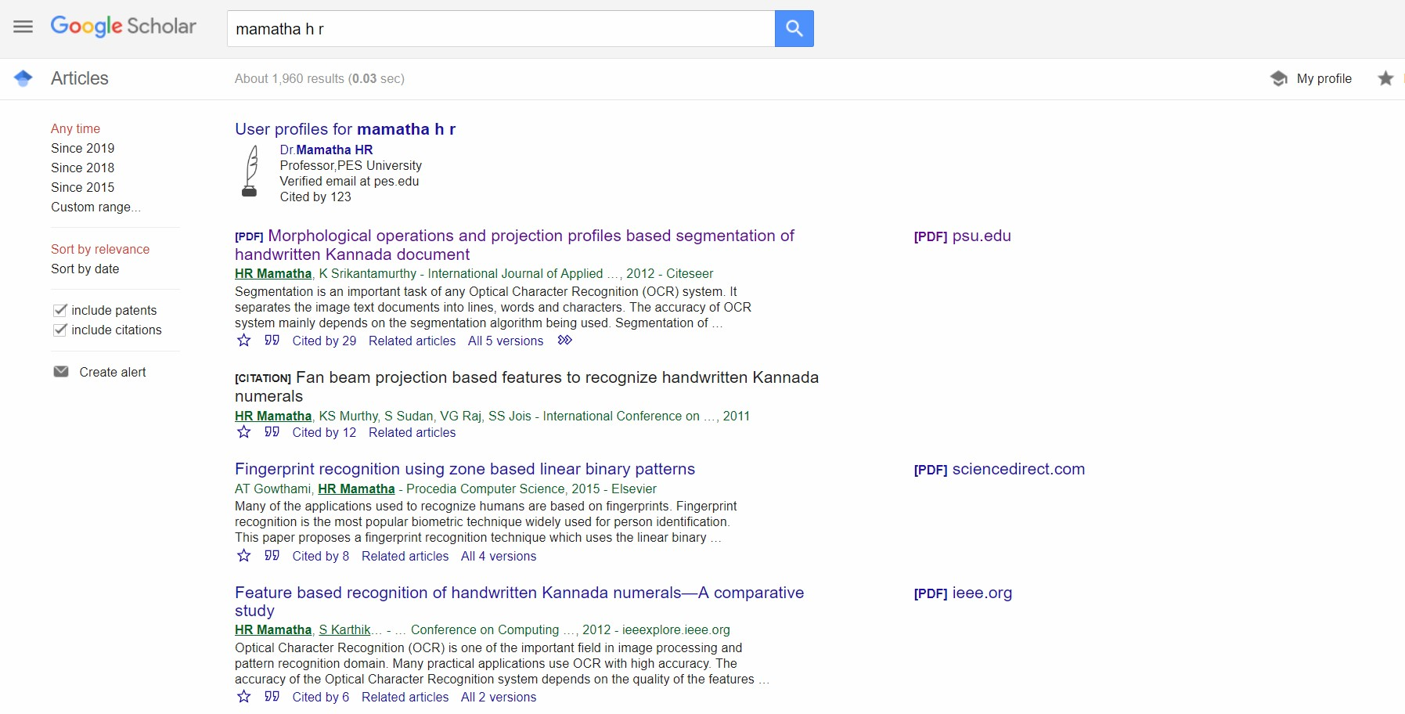
Google Scholar is a real world counterpart

Slide 6
Features of the Project
1. Searching the Information of a project based on Faculty name,Domain name etc
2. Adding new details into the database by
Publications
Patents
Proposals
3. Adding new project details through any text file.
(Constraints should be taken care, Faculty names should be separated by ‘,’ and the name of the project should be within “ “ .

Slide 7
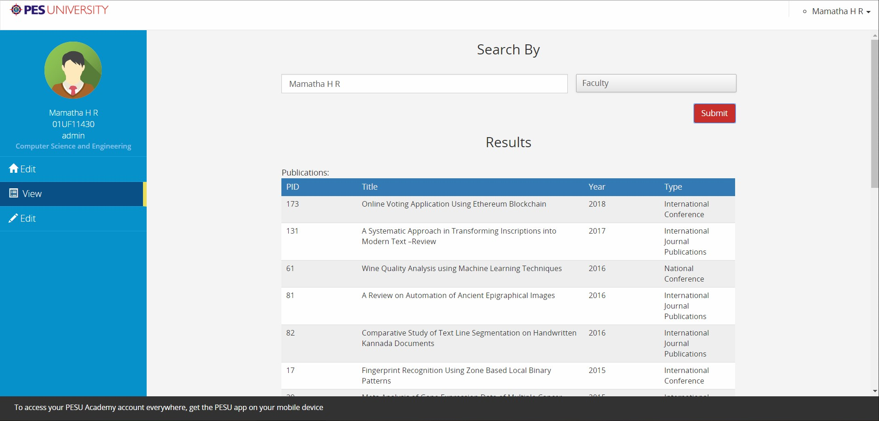
Searching by Faculty Name

Slide 8
View the Year wise Progress or
Achievements of the Faculty

Slide 9
Problems created and steps to solve the problem
Scalabilty: Since portal is placed on a normal server it suffers from lag to dynamically generate graphs in case of too many requests.So should be put on a commercial server.
Concurrency: In case of a person being already logged in and simultaneously data used to generate the graph is changed by another person it causes write after read problem.Can be solved by assigning transaction ids and refreshing everytime some transaction happens.

Slide 10
Thank You

